Slide 1
Master of Puppets MoPs
Team 9
Conference room DEIB
July 16, 2016
Tommaso Chiarandini <tommaso.chiarandini@mail.polimi.it>
Tommaso Ciceri <tommaso.ciceri@mail.polimi.it>
Bianca Falcone <bianca.falcone@mail.polimi.it>
Virginia Galli <virginia.galli@mail.polimi.it>
Politecnico di Milano

Slide 2

Introduction
MoPs (Master of Puppets) is a device for the Functional Electrical Stimulation (FES).
The masters of puppets!

Slide 3
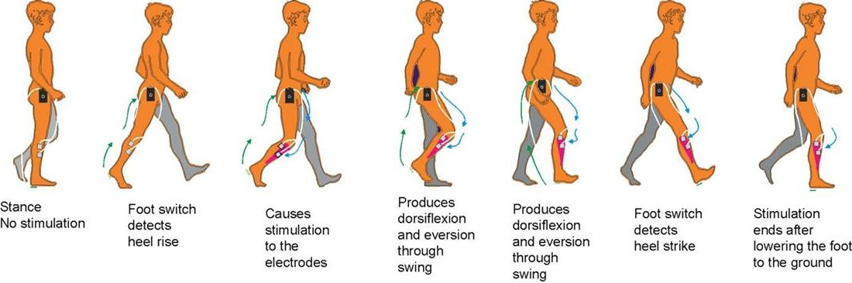
FES
Uses low energy electrical pulses to artificially generate body movements;
Employed for the cure of several motor disorder (drop foot, stroke, multiple sclerosis).

Slide 4
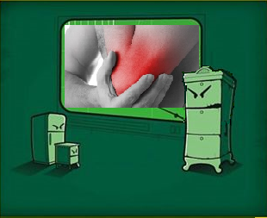
Ulnar nerve
Do you remember that annoying tingling when you bump
your elbow ?
It’s the ulnar nerve!
Our idea for the stimolation

Slide 5
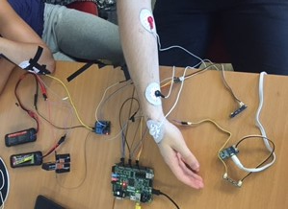
Hardware Setting
Electrodes
EMG sensor and its electrodes
Power Supply
Relay
Zybo board

Slide 6
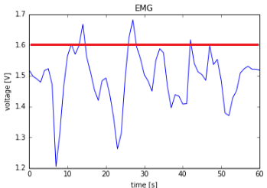
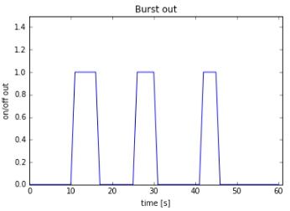
Block diagram
6
ADC converter
data analysis wrt
a threshold
EMG
data collection
ZYBO
Jupyter Notebook
E
I
E/I
Electrodes
patient’s nerve
Relay
biphasic
fz=40Hz

Slide 7
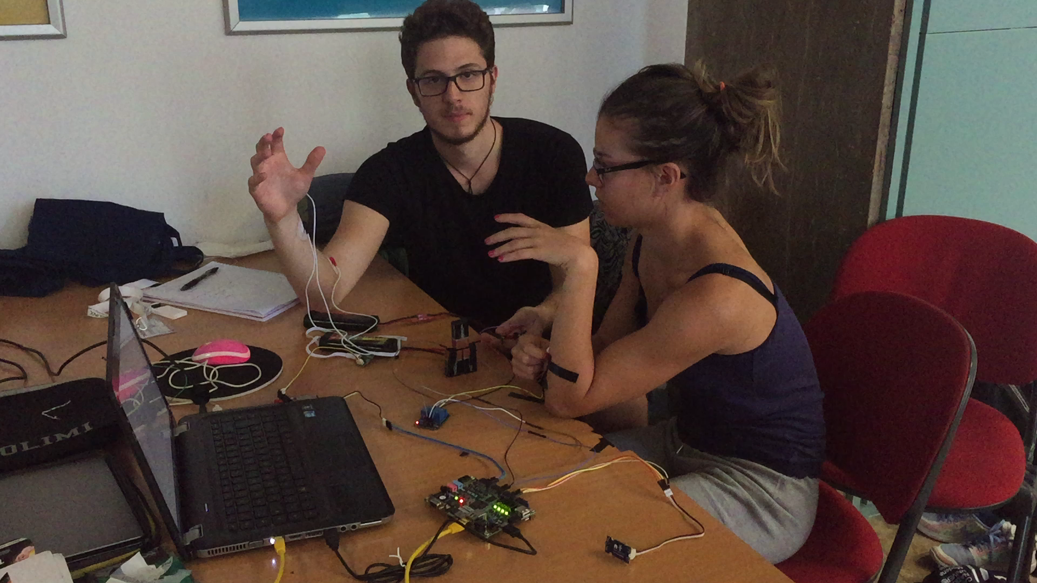
Demo

Slide 8

Team 9
Questions?
Tommaso Chiarandini tommaso.chiarandini@mail.polimi.it
Tommaso Ciceri tommaso.ciceri@mail.polimi.it
Bianca Falcone bianca.falcone@mail.polimi.it
Virginia Galli virginia.galli@mail.polimi.it

